Slide 1
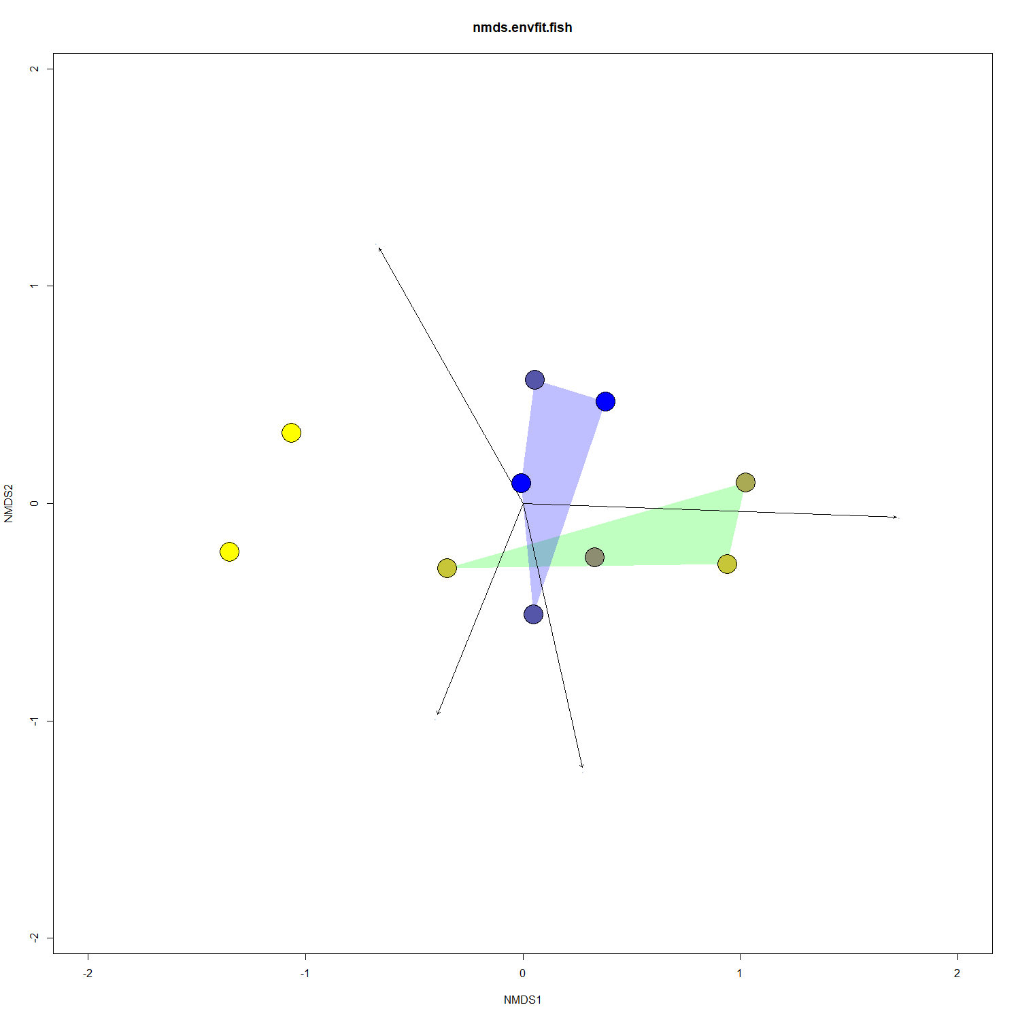
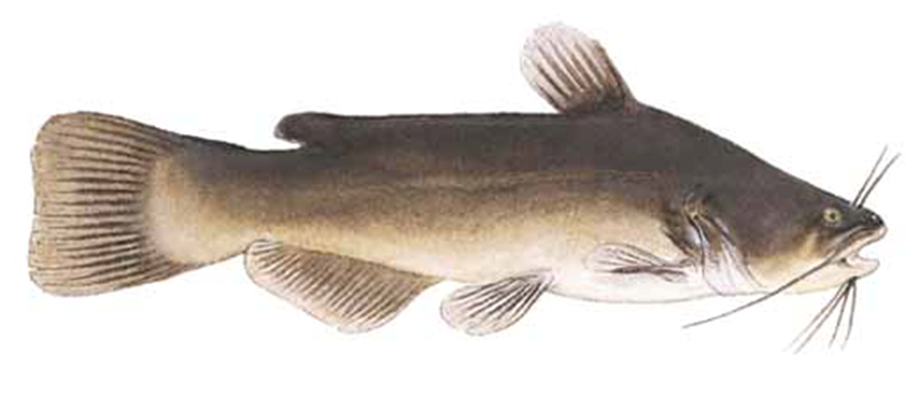
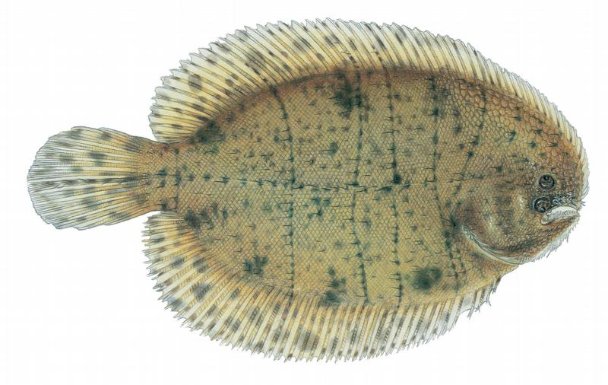
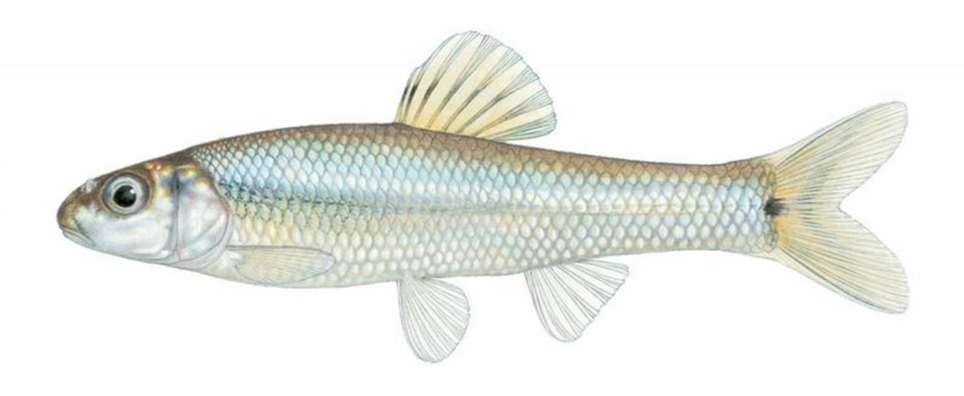
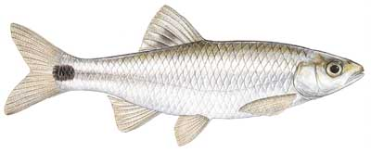
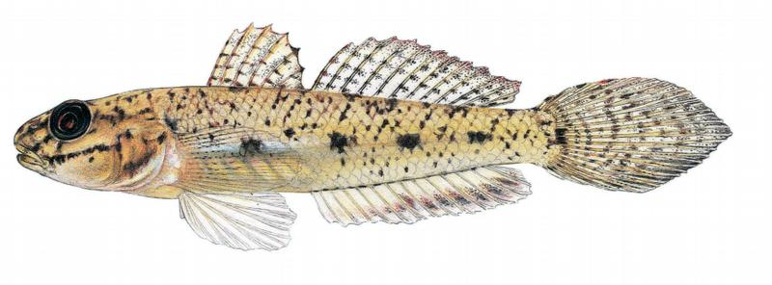
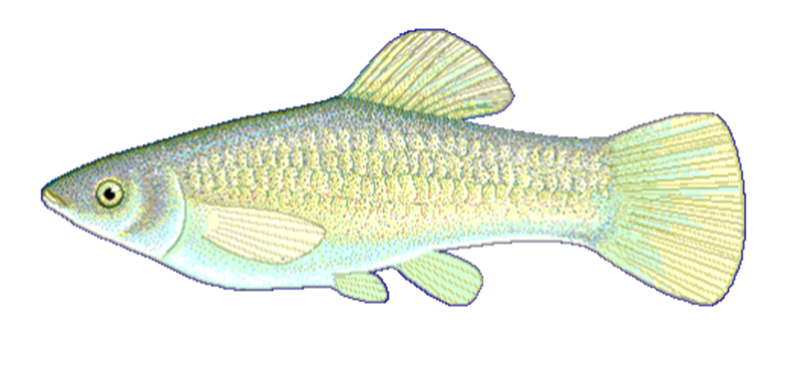
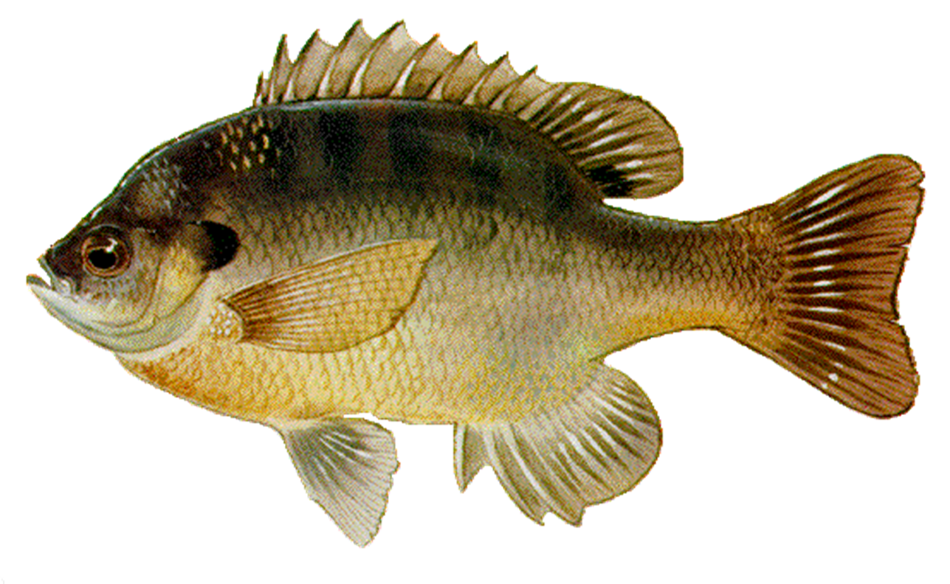
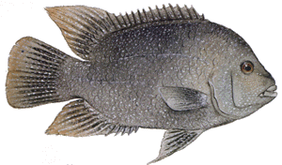
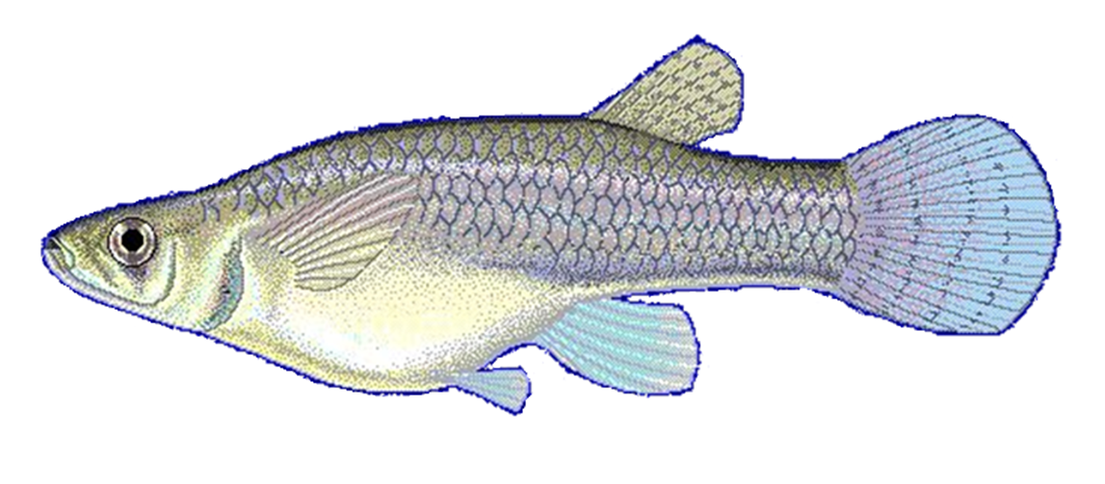
1.5
Precipitation
1.0
A. melas
T. maculatus
0.5
P. vigilax
C. venusta
Sub-Humid
E. gracile
NMDS2
Semi-Arid
Ammonia
-0.0
Mesic
-0.5
P. formosa
L. macrochirus
H. cyanoguttatus
-1.0
G. affinis
Riparian
Farm
Phosphate
-1
0
1
2
NMDS1
NMDS ordination of fish communities in ten coastal prairie streams in South Texas.
Sites are grouped according to Annual Precipitation.
Distances between sites are proportional to compositional differences in community.
The explanatory power of environmental factors is indicated by the length and direction of the arrows.
Labeled Illustrations indicate the location of various species within the ordination space.

Slide 2
1.5
Precipitation
1.0
A. melas
T. maculatus
0.5
P. vigilax
C. venusta
Sub-Humid
E. gracile
NMDS2
Semi-Arid
Ammonia
-0.0
Mesic
-0.5
P. formosa
L. macrochirus
H. cyanoguttatus
-1.0
G. affinis
Riparian
Farm
Phosphate
-1
0
1
2
NMDS1
NMDS ordination of fish communities in ten coastal prairie streams in South Texas.
Sites are grouped according to Annual Precipitation.
Distances between sites are proportional to compositional differences in community.
The explanatory power of environmental factors is indicated by the length and direction of the arrows.
Labeled Illustrations indicate the location of various species within the ordination space.

Slide 3
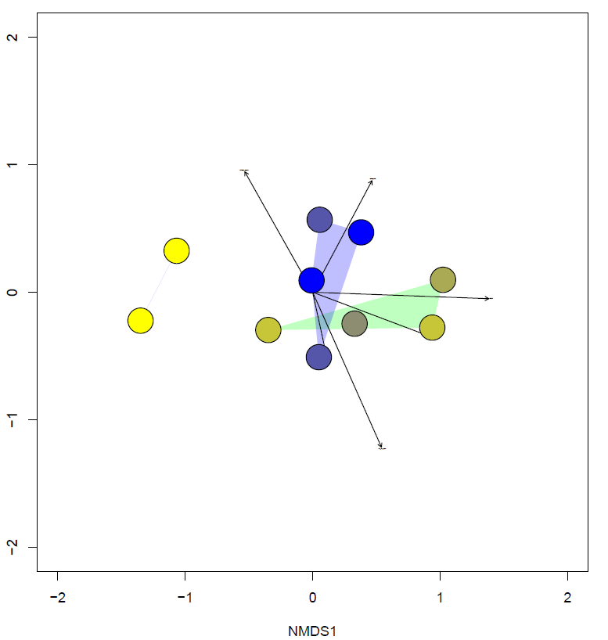
Annual
Rainfall
Canopy
Coverage
Semi-Arid
NH4+
Low Flow Pulse %
Outfall
Density

Slide 5
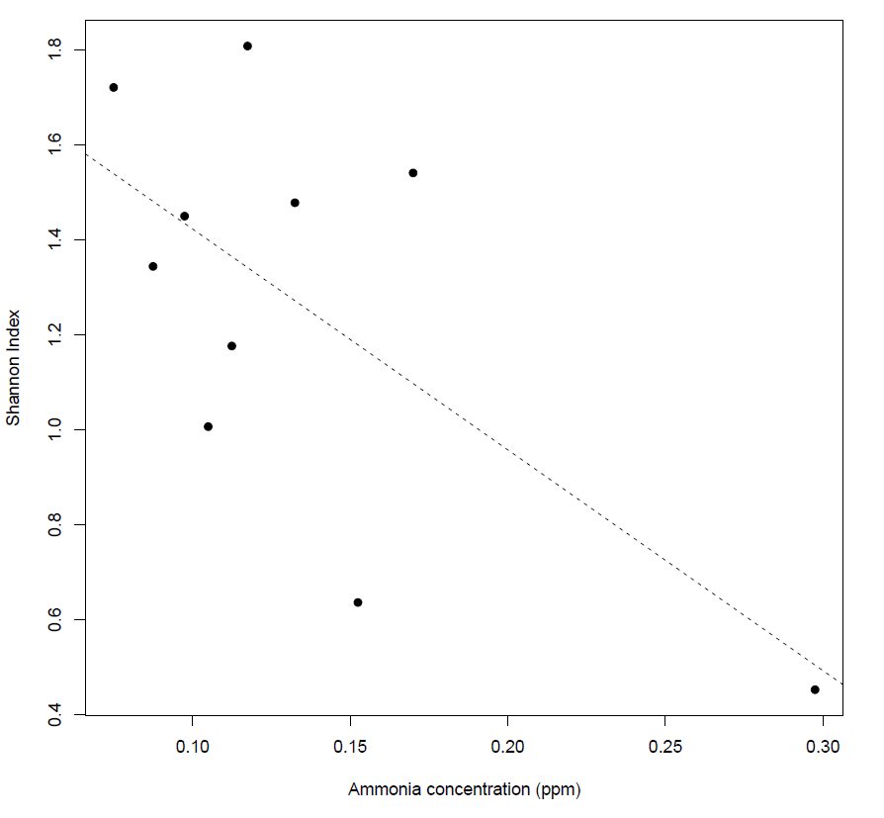
1.8
S = – 4.6474(N)+ 1.8873
R² = 0.4451
p = 0.03509
1.6
1.4
1.2
Shannon Index
1.0
0.8
0.6
0.4
0.10
0.15
0.20
0.25
0.30
0.10
Ammonia Concentration (ppm)

Slide 6
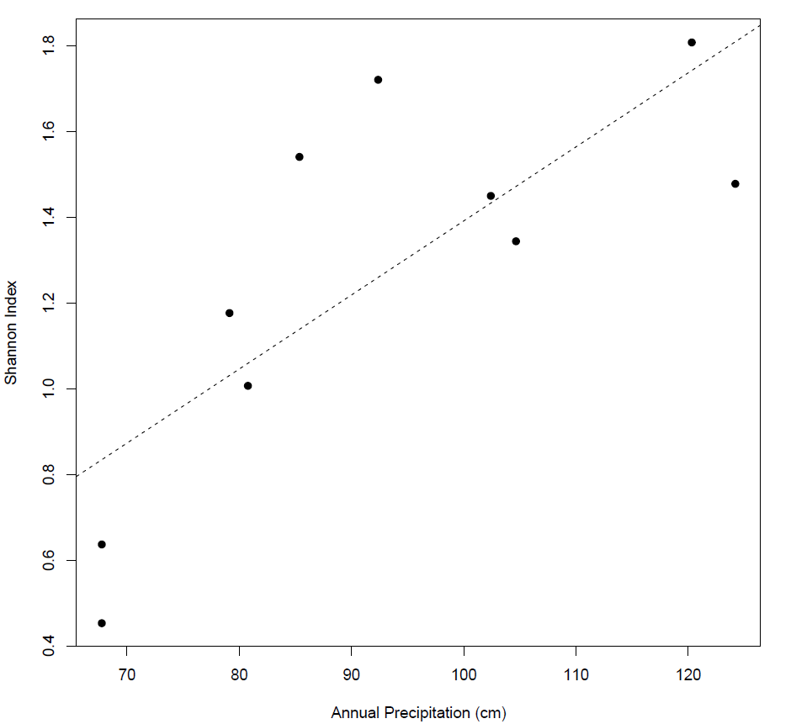
1.8
1.6
1.4
1.2
Shannon Index
1.0
0.8
0.6
S = 0.017271(P) + 0.00834
R² = 0.602
p = 0.008336
0.4
70
80
90
100
110
120
Annual Precipitation (cm)

Slide 7
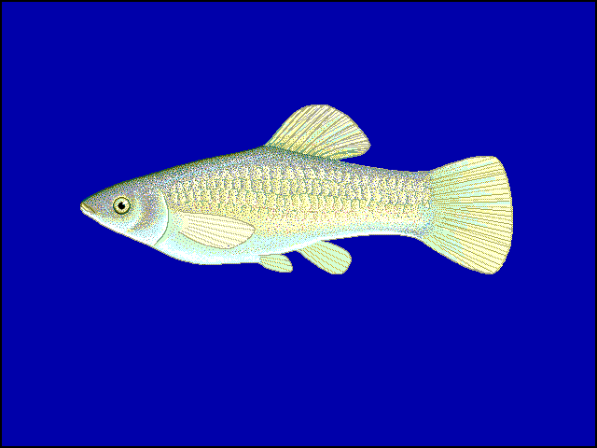
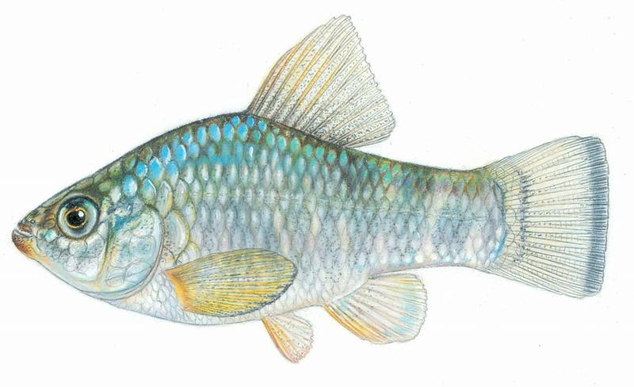
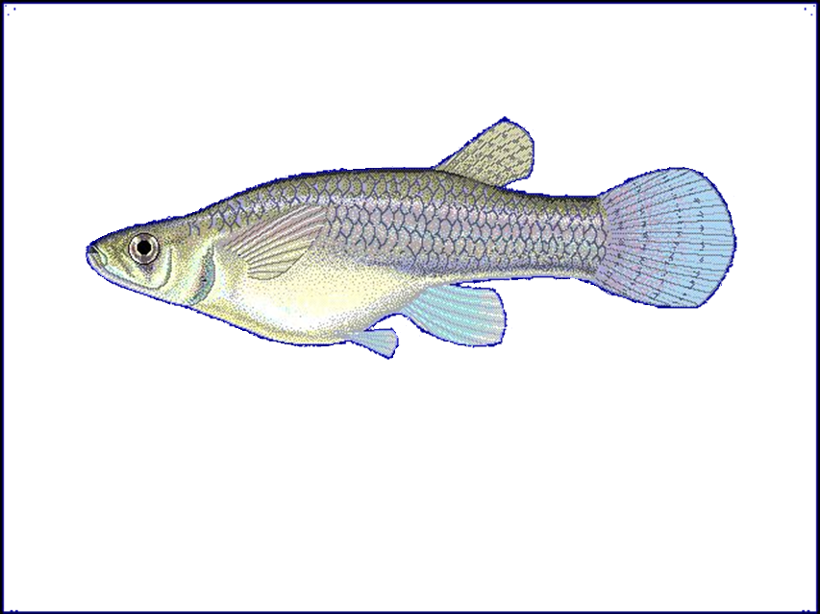
Poecilia Formosa
No copyright. Public Domain
Cyrpinodon variegatus
Credit: Joseph R. Tomelleri
Gambusia affinis
Credit: Robbie N. Cada

Slide 8
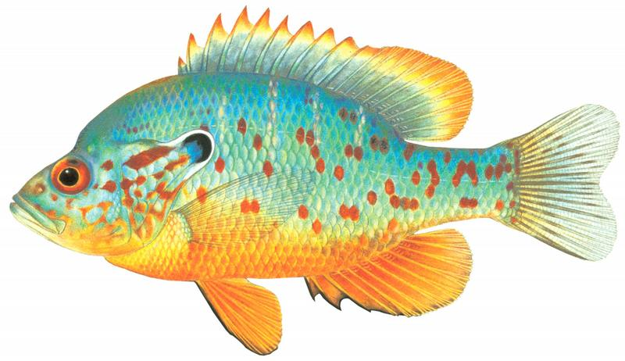
Lepomis humilis
Credit: Joseph R. Tomelleri
Trinectes maculatus
Credit: Joseph R. Tomelleri
Ctenogobius shufeldti
Credit: Joseph R. Tomelleri

Slide 9
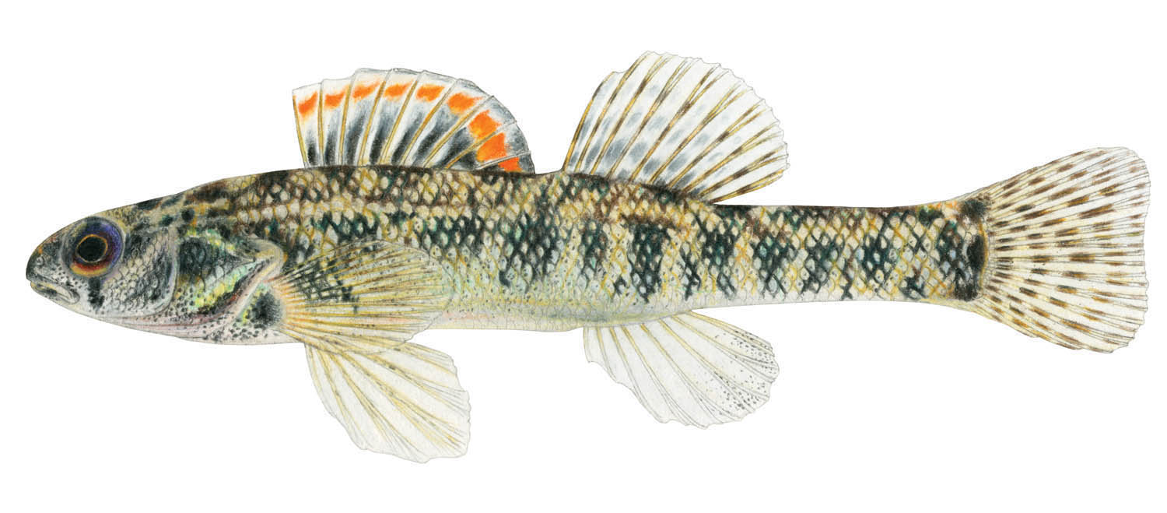
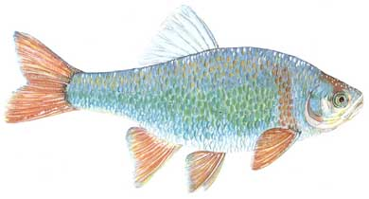
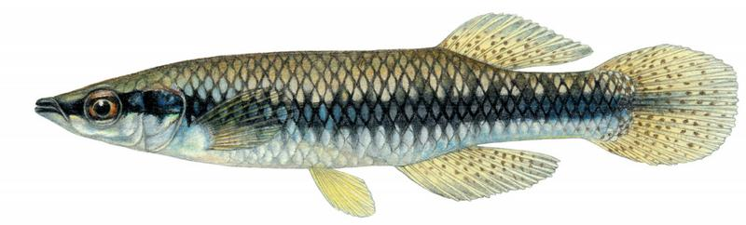
Etheostoma gracile
Credit: TNACI FIN
Cyrpinella lutrensis
Credit: TPWD
Fundulus notatus
Credit: Joseph R. Tomelleri

Slide 10
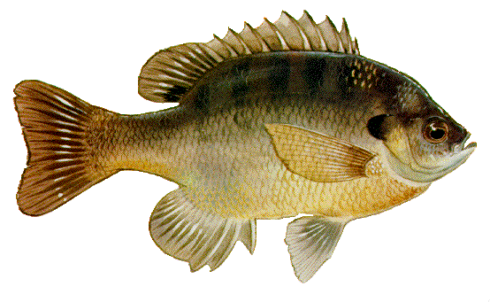
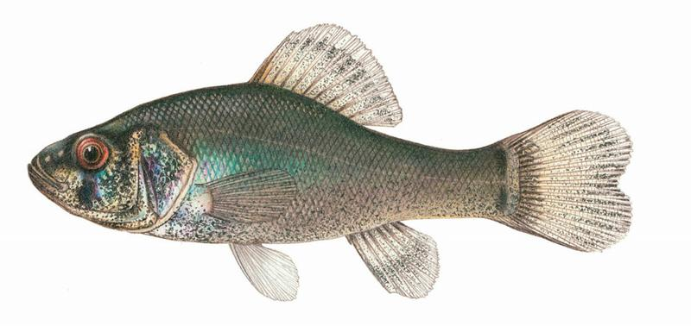
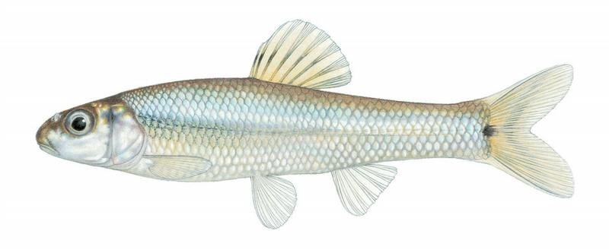
Lepomis macrochirus
Credit: TPWD
Aphredoderus sayanus
Credit: Joseph R. Tomelleri
Pimephales vigilax
Credit: Joseph R. Tomelleri

Slide 11
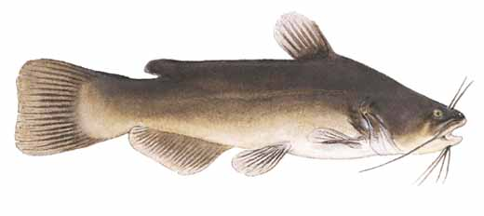
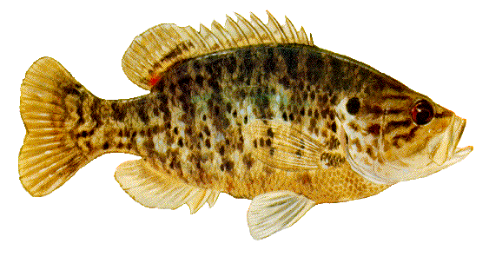
Ameiurus melas
Credit: TPWD
Cyprinella venusta
Credit: TPWD
Lepomis gulosus
Credit: TPWD

Slide 12
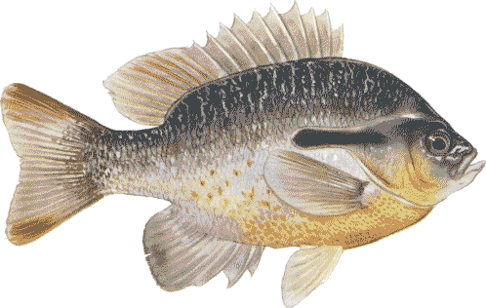
Lepomis auritus
Credit: TPWD
Herichthys cyanoguttatus
Credit: TPWD

